Slide 1

BUS TRIPS RESERVING SYSTEM (BTRS).
Project

Slide 2
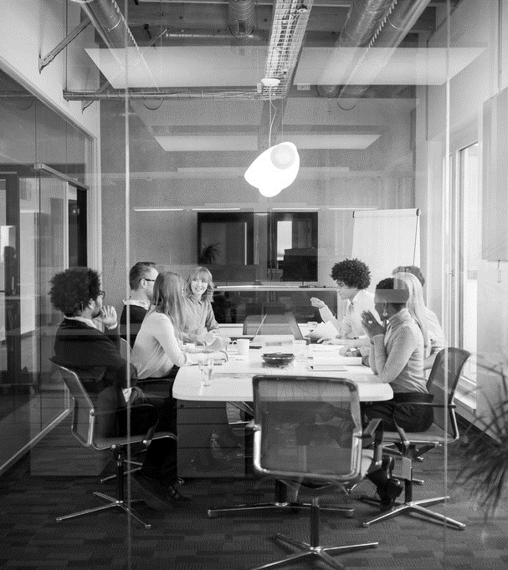
Agenda
INTRODUCTION
PROBLEM
SOLUTION
DEVELOPMENT PROCESS
SUGGESTIONS FOR ENHANCEMENT

Slide 3
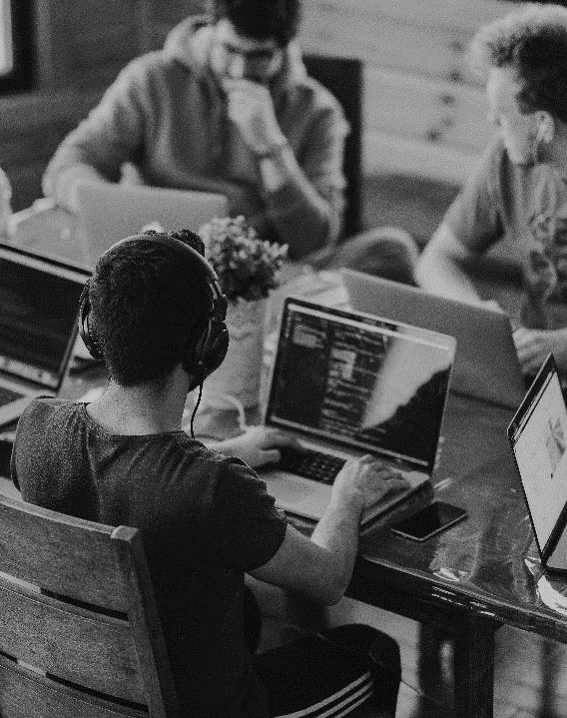
INTRODUCTION
Welcome to the future of bus travel with ABC Bus Travels! As a pioneering and customer-centric bus-traveling company, we are thrilled to introduce our groundbreaking initiative – the Bus Trips Reserving System (BTRS). With an unwavering dedication to elevating your travel experience, ABC Bus Travels aims to redefine convenience, efficiency, and technology-driven services in the realm of online bus reservations.

Slide 4

Let’s Dive In

Slide 5
problem
Manual Booking Processes: The current manual booking processes contribute to delays, errors, and a lack of real-time information. Passengers often find it cumbersome to book bus trips, impacting their overall travel experience.
Inadequate Information Access: Passengers lack a centralized platform to access comprehensive details about available bus trips. The absence of an organized listing makes it challenging for them to make informed decisions regarding their travel plans.
Limited Administrative Control: Administrators face difficulties in managing and updating bus trip information efficiently. The lack of a privileged system prevents them from seamlessly adding or removing trips and maintaining an up-to-date database.

Slide 6
SOLUTION
Efficient Booking and Management:
Problem: Manual and error-prone booking and management processes.
Solution: Design a robust system that allows passengers to book multiple trips and each trip to accommodate multiple passengers. Implement a streamlined page displaying all bookings for passengers, ensuring transparency and easy management.
Administrator Privileges:
Problem: Limited control and difficulties in managing bus trip announcements.
Solution: Grant privileged access to administrators through secure logins. Provide them with an admin account containing an ID, username, password, and full name. Enable administrators to effortlessly add and delete trips, buses, and manage overall system operations.
6

Slide 7

DEVELOPMENT PROCESS
Project Setup: Create an ASP.NET Core MVC Project with the name "BTRS." Set up a SQL Server database named "BTRS."

Slide 8
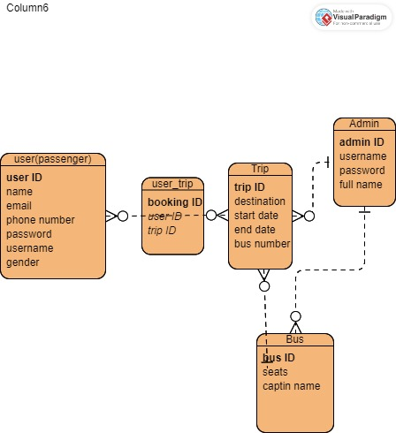
Passenger Pages: Identify and design all the required pages for passengers, creating sketches using digital tools like MS Paint, Figma, or by hand (if needed).

Slide 9
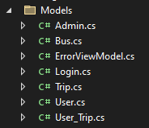
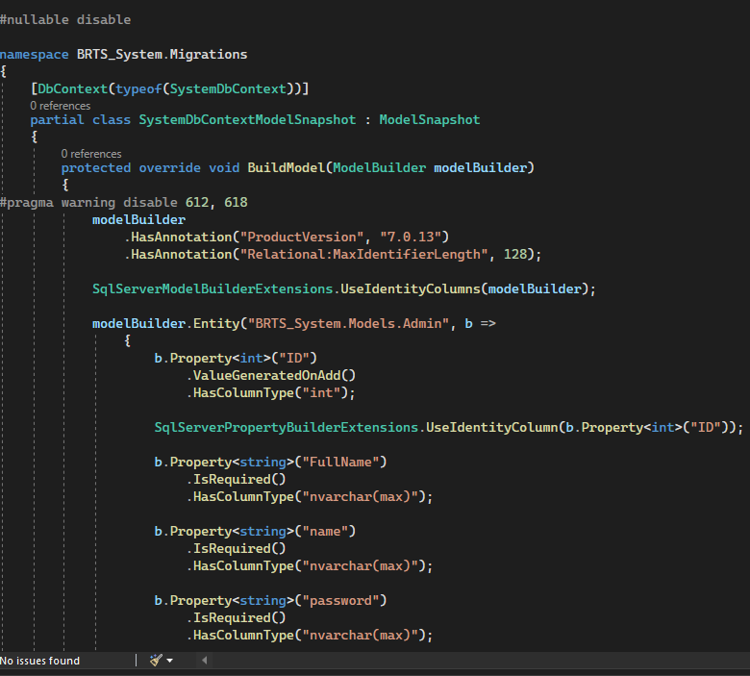
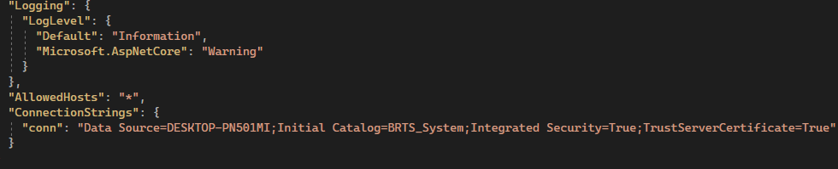
Database Integration:
Connect the web application with the "BTRS" database using Entity Framework Core and create the necessary tables based on the model classes. This involves configuring EF Core to map your model classes to database tables and handling migrations for database schema changes.
Model Classes: Develop model classes in the "model" folder, including attributes and constraints using annotation classes.

Slide 10
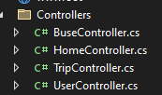
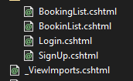
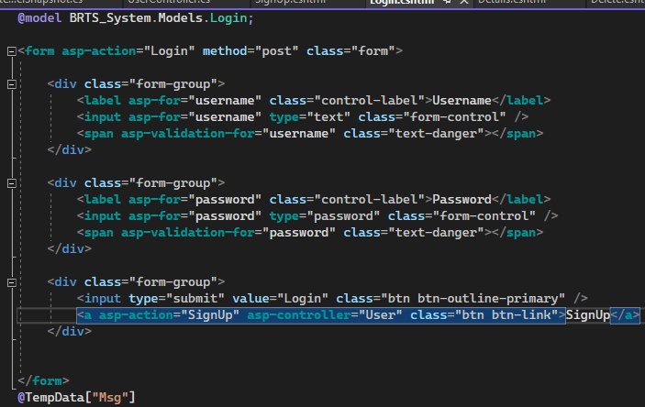
Create the controllers starting with the user controller
Create the user Views
EMPLOYEE OPPORTUNITIES
Interns begin
Indoor rec leagues
Chess tournaments
Big Game watching party
Passenger Views: Implement passenger views using HTML helpers with Bootstrap for styling. Include functionality and validation to prevent duplicate usernames, phone numbers, email addresses, and handle empty inputs.

Slide 11
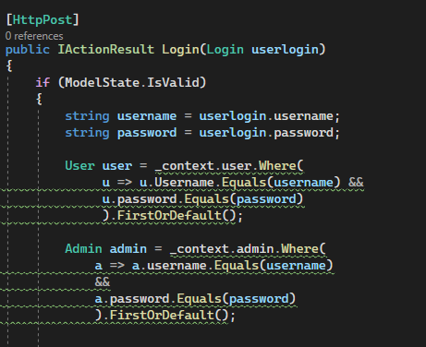
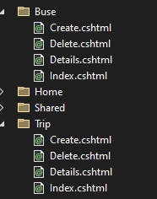
Admin and user login
Develop controllers and views for admin login and management.
Create admin roles and implement authorization.
Enable administrators to add and delete trips, manage buses, and oversee the system.

Slide 12
SUGGESTIONS FOR ENHANCEMENT Notification System: Booking Confirmations: Implement an automated email or SMS notification system to confirm bookings and provide trip details to passengers. Admin Alerts: Set up notifications for administrators regarding new bookings, cancellations, or other critical updates.

Slide 13

THANK YOU
Zena Nusair
Anas

